Slide 1
Capstone Project1
Play Store Apps Review Analysis re Apps Review Analysis By Deepmala Srivastava Data Science Trainee ~ AlmaBetter

Slide 2
Contents
Introduction
Data Description
Analysis Methodology
Data Visualization
Conclusion

Slide 3
Introduction
Google Play Store, is where we can download or buy millions of apps, games, and other media onto Android device.

Slide 4
Objective
Performed Exploratory data analysis to discover following key factors responsible for app engagement and success.
Application Types in Play Store
Categories in Play Store
Size of Apps
App ratings
Sentiment reviews

Slide 5
Data Description
The project is an Exploratory Data Analysis of two data sets of Play Store which are:
Play Store Data
User Reviews

Slide 6
Play Store Data
It consists of 13 columns with 10841 Rows :-
App,
Category,
Rating,
Reviews,
Size,
Installs,
Type,
Price,
Content Rating,
Genres,
Last Updated,
Current Ver,
Android Ver.

Slide 7
User Reviews data
Apps
Translated Review
Sentiments
Sentiment Polarity
Sentiment Subjectivity

Slide 8
Analysis Methodology
It has three parts:
Integral research:
basic information of data: shape, columns, datatype
some issues : missing values ,data duplications and etc.
Data cleaning and filtering
Data visualization

Slide 9
Data Cleaning and Filtering
Many missing values in Size & Rating columns initially remove duplicate values from the data before we start cleaning it up.
Identify the distinct values for each column and make the appropriate adjustments, such as changing the data types and getting rid of the null and "nan" values.

Slide 10
Data Visualization
Distribution of Application Type
Number of Apps per Category
Number of installs type-wise according to categories
Top genres in playstore
Number of installs for each category
Number of apps per category differentiated
Distribution of Size of app
Impact of size on the number of installs
Distribution of App Rating
Install per Rating
Rating on the basis of Size
Reviews Sentiment
Number of installs type wise according to Genres
Distribution of Subjectivity
Sentiment subjectivity and Sentiment Polarity
Content Rating on the basis of Age
Sentiment polarity relation with type of app
Content Rating relation with Sentiment Polarity
Categories Relation with Sentiment Polarity

Slide 11
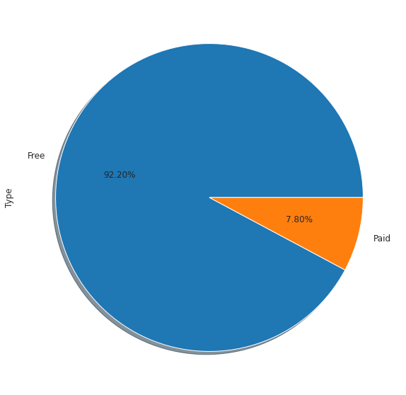
Distribution of Application Type
Play Store has 92.2% Free apps and only 7.80% are paid apps.

Slide 12
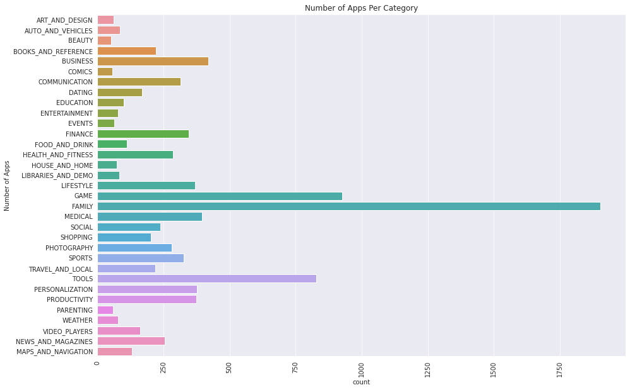
Number of Apps per Category
Most of the apps are from the categories of 'Family', 'Game' and 'Tools' category.

Slide 13
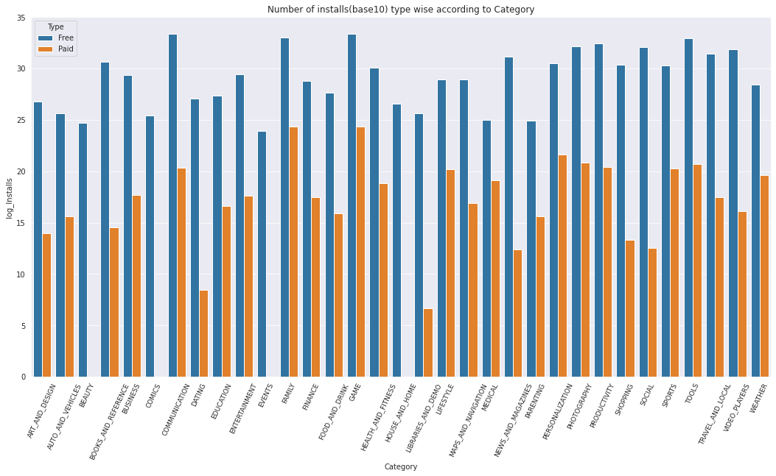
Number of Installs Type-wise according to Categories
App installations have a significantly higher proportion of free software than paid ones.

Slide 14
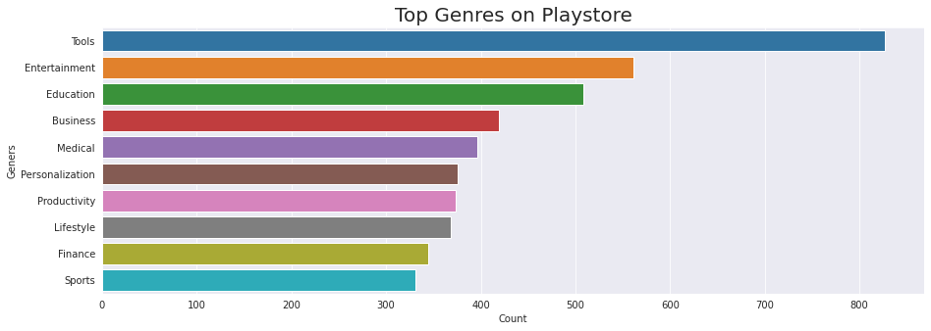
Top Genres in Playstore
The top genres in our data set is Tools followed by entertainment, education, business, medical apps and so on.

Slide 15
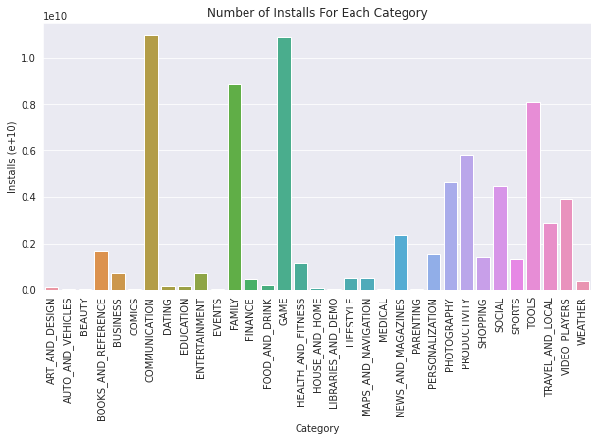
Number of installs for each category
Games, communication, Family and tools have the most installed apps.

Slide 16
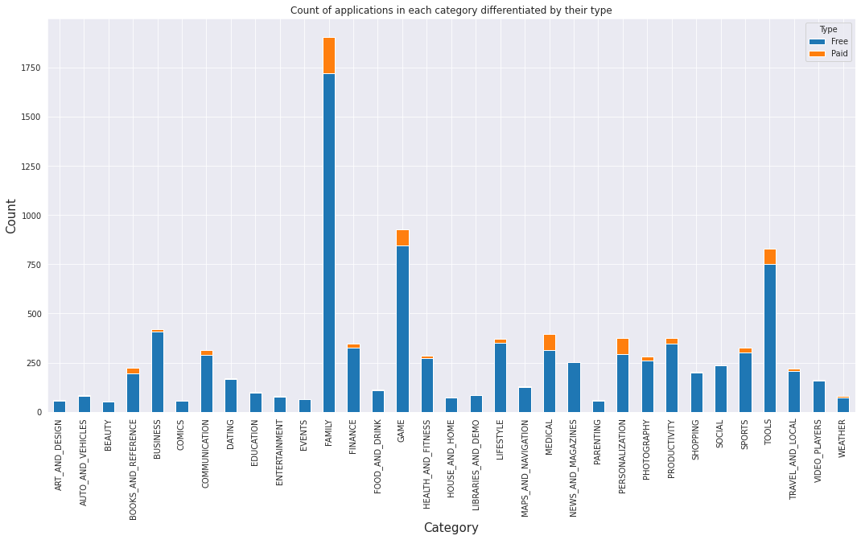
Number of apps per category differentiated by type
Most free app download categories: Family, Games, Tools and Social
Most paid apps download categories: Family, Personalization, and Medical

Slide 17
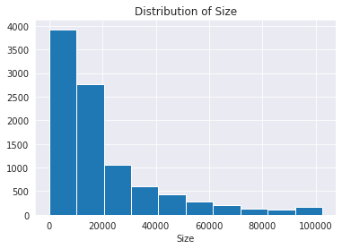
Distribution of Size of app
Most of the apps present in Play Store are smaller in size and consume less memory

Slide 18
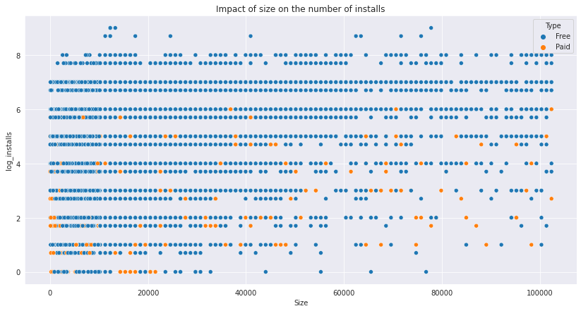
Impact of size on the number of installs
Size affects the installs of apps by the user.

Slide 19
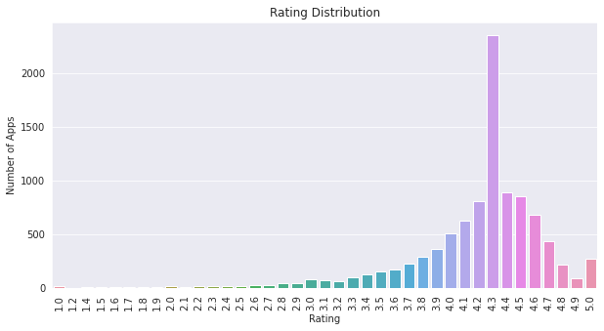
Distribution of App Rating
Most of the apps in the Play Store are having rating higher than 4 or in the range of 4 to 4.7.

Slide 20
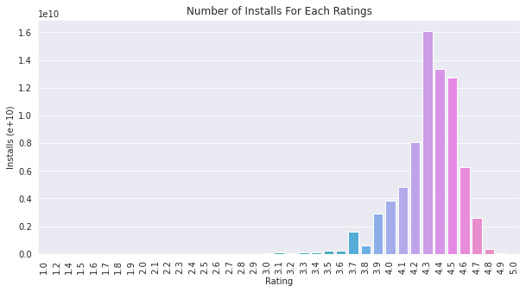
Install per Rating
Most of the apps downloaded by the customers are of higher rating ( 4.2 to 4.6 ratings).

Slide 21
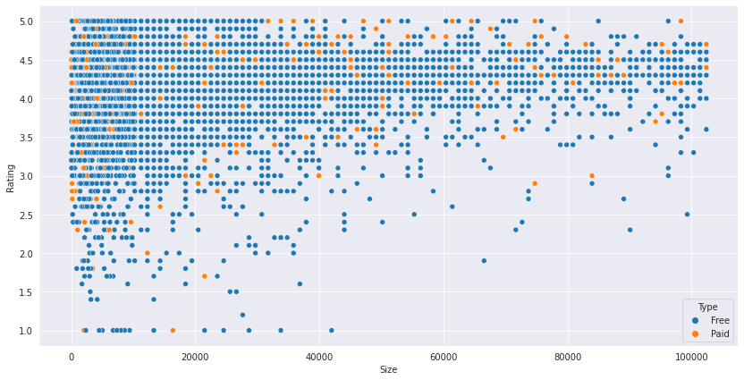
Rating on the basis of Size
Most of the apps with higher rating are smaller apps in size.

Slide 22
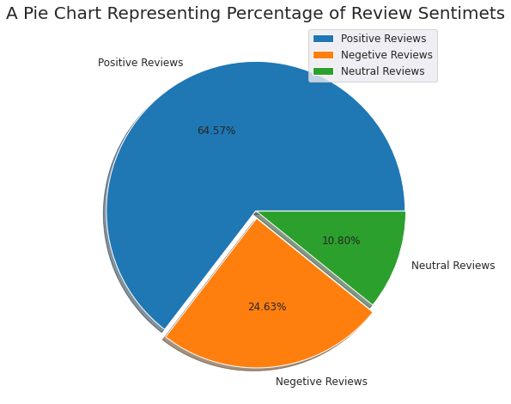
Reviews Sentiment
Most of the reviews are positive in nature with 64.57%
Negative reviews are only 24.63%.
Neutral reviews are only 10.8%.

Slide 23
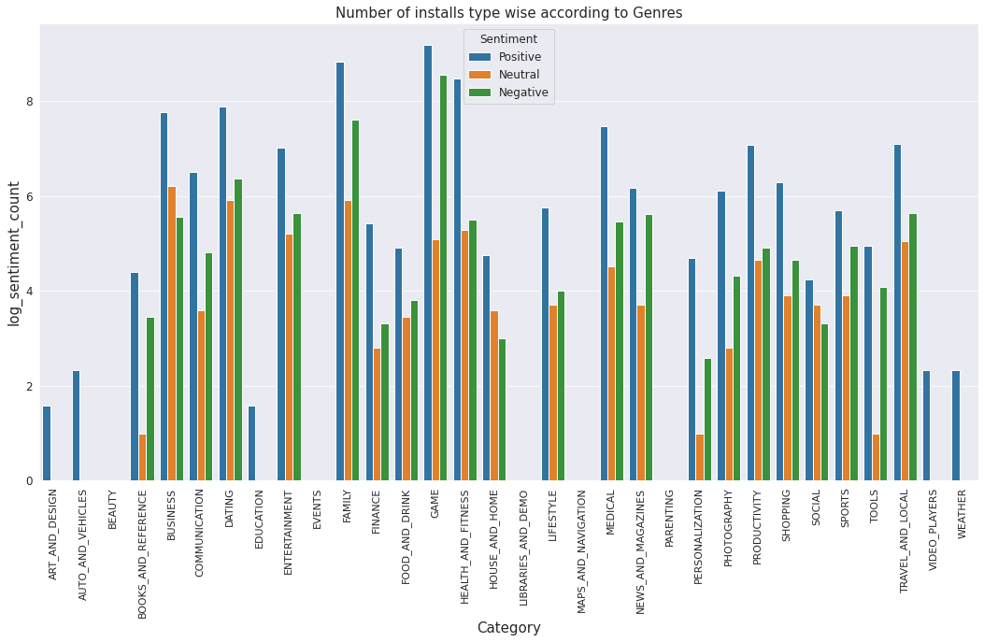
Number of installs type wise according to Genres
Positive reviews are higher in each category of Play Store data,
Some categories such as Game and Business have very less difference in the positive and negative reviews.
Some categories such as House and Home and Business where neutral reviews are also very large as compared to negative reviews

Slide 24
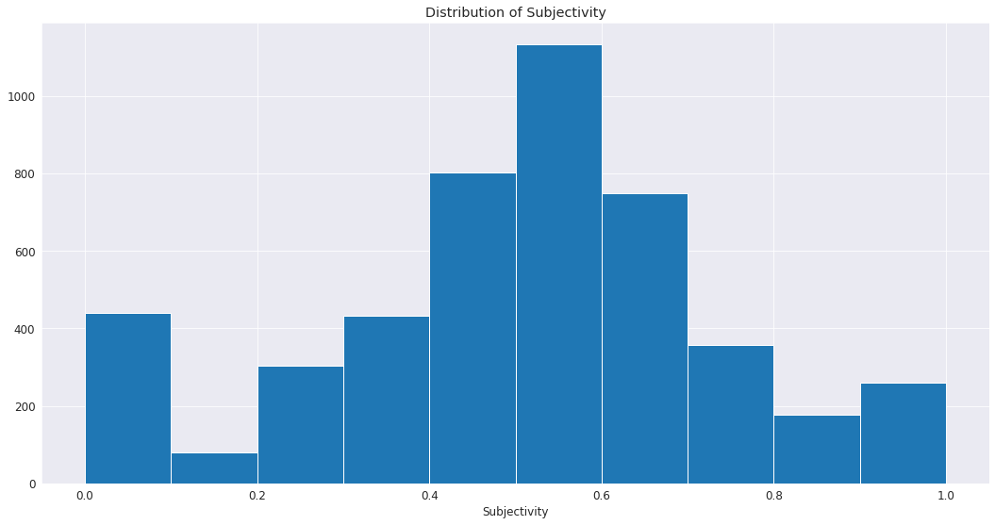
Distribution of Subjectivity
Maximum number of sentiment subjectivity lies between 0.4 to 0.7.
These reviews comes from the experience from the users while using these apps.

Slide 25
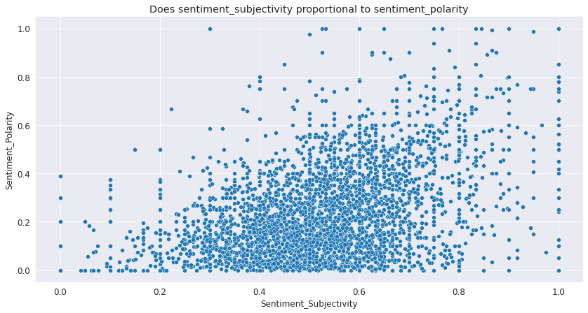
Sentiment subjectivity and Sentiment Polarity
Sentiment subjectivity is not always proportional to sentiment polarity but in maximum number of cases, it shows a proportional behaviour when variance is too high or low.

Slide 26
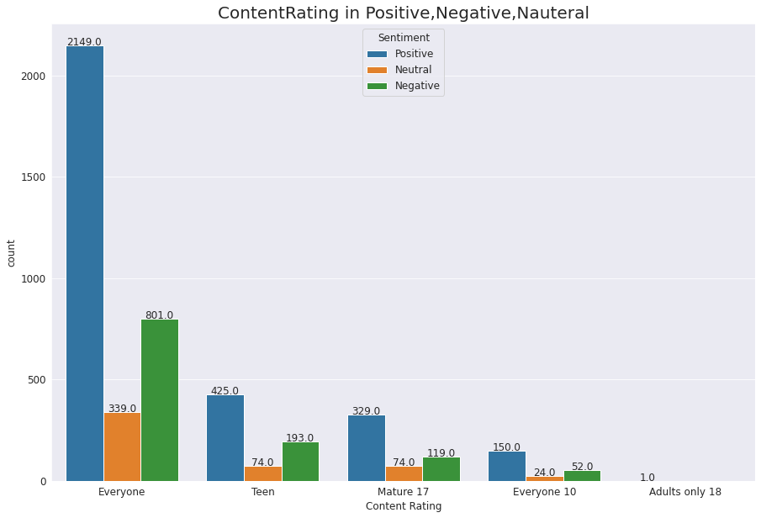
Content Rating on the basis of Age
Most of the Ratings came from the Everyone category and the ratings gone lesser when we move forward with the age criteria of the apps and gone to even 1 when comes to the adults only category.
In Sentiment of the review , most of the positive ratings came from the everyone category apps with 2149 ratings and 801 negative ratings.
Neutral ratings are also low in comparison to positive and negative reviews.

Slide 27
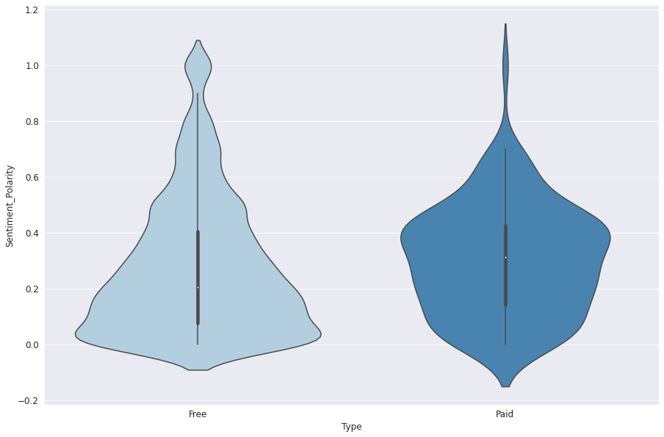
Sentiment polarity relation with type of app
In Free apps the sentiment polarity lies majorly in 0.1 and decreases after that which shows that only a handful of users give reviews after experiencing apps.
The sentiment polarity of paid apps which falls majorly between 0.1 to 0.4 with highest in 0.4. customers first experience these apps and then gave their reviews about those apps.

Slide 28
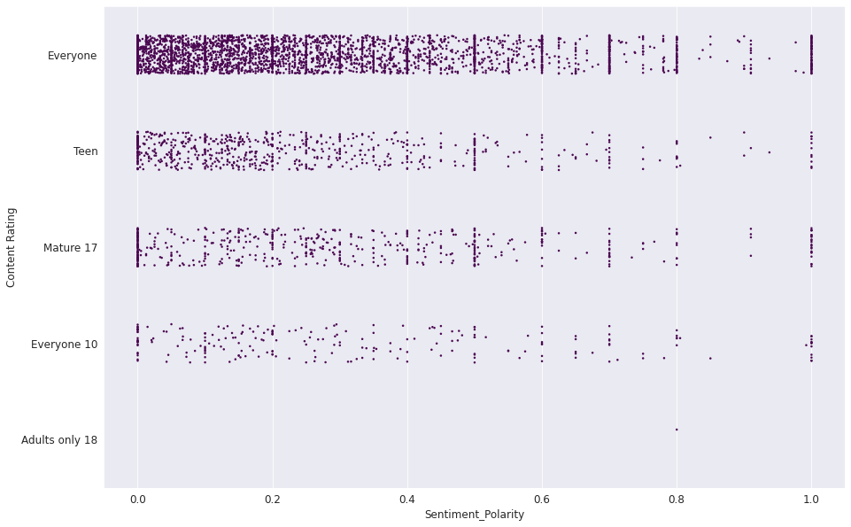
Content Rating relation with Sentiment Polarity
Sentiment polarity is low in all categories but in above 10 category of Content Rating
Sentiment polarity is evenly distributed, so that users have first used the app and then they give their reviews but this can also be seen as less number of reviews in that category.
In Everyone category has highest number of reviews but major part of those reviews lies between 0.1 to 0.4 and not more reviews are going higher than that, in this we can say that customers have not used those apps and gave their reviews beforehand.

Slide 29
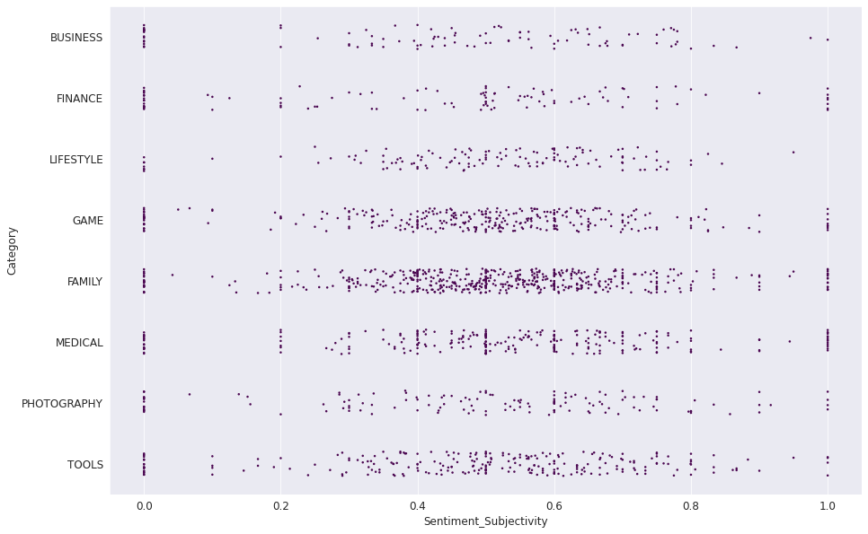
Categories Relation with Sentiment Polarity
Sentiment Polarity lies between 0.2 to 0.8 in all Categories,
Family Category has the higher number of reviews in which Sentiment Polarity lies between 0.4 to 0.6 which shows that apps in this Category have been reviewed after using them.

Slide 30
Asking from Analysis
How does size impact on the number of installs?
How does size impact the ratings of any app?
What is the distribution of apps in terms of their ratings, size and type?
How sentiment is divided for different type of reviews?
What is the distribution of type of reviews, category wise in the data set?
Is sentiment subjectivity proportional to sentiment polarity?
Age vs sentiment: each age with its Positive, Negative, Nauteral sentiment
Sentiment Polarity relation with paid and Free App
Content Rating Relation with Sentiment Polarity
Categories Relation with Sentiment Subjectivity
A quick look on reviews through Word cloud

Slide 31
Conclusion
Most of the trending apps (in terms of users' installs) are from the categories like GAME, COMMUNICATION, and TOOL even though the amount of available apps from these categories are twice as much lesser than the category FAMILY.
Most of the apps having good ratings of above 4.0 are mostly confirmed to have high amount of reviews and user installs.
Futhermore, most of the apps that are having high amount of reviews are from the categories of SOCIAL, COMMUNICATION and GAME like Facebook, WhatsApp Messenger, Instagram, Messenger – Text and Video Chat for Free, Clash of Clans etc.
Apps from the categories like GAME, SOCIAL, COMMUNICATION and TOOL of having the highest amount of installs, rating and reviews are reflecting the current trend of Android users, they are not even appearing as category in the top 5 most expensive apps in the store (which are mostly from FINANCE and LIFESTYLE).
As a conclsuion, we learnt that the current trend in the Android market are mostly from these categories which either assisting, communicating or entertaining apps.

